Slide 1

Powerpoint Edition

Slide 2
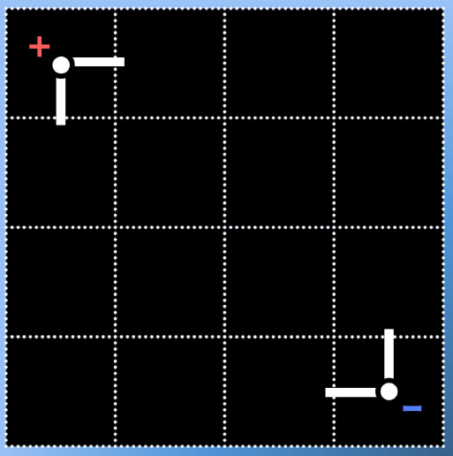
Game Board will be drawn on whiteboard
1 2 3 4
A
B
C
D

Slide 3

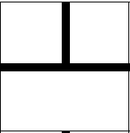
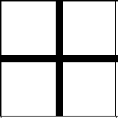
Bulb lights up
1 2 3 4
A
B
C
D

Slide 4
Rules
Turn-based game, using grid coordinates
Each group has the following tiles:
Place one of them in any orientation at any turn of the game.
Objective: get maximum brightness out of your 2 bulbs.
light bulbs x 2
T-shaped wires x 3
Cross-shaped wires x 2

Slide 5
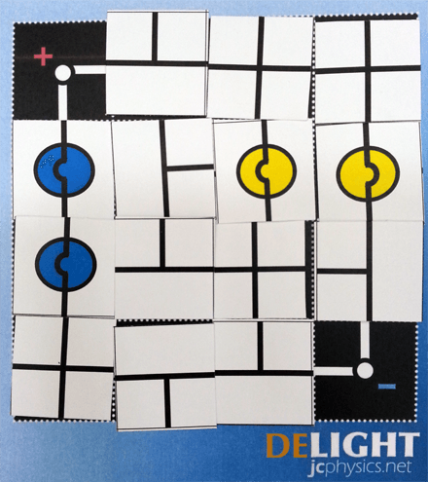
Test Yourself: Who is the winner?

Slide 6
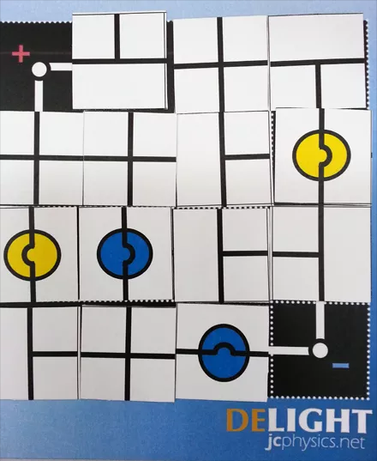
Test Yourself: Who is the winner?

Slide 7
Physics Concepts in this Game
What determines brightness of bulb?
P = V²/R
2. Potential divider rule
3. Wires bypassing a device short-circuits it

